Slide 1


Tanzania Public Service College
Subject: internet programming
Instructor.Mr Hamis Mashaka
Course: DIT 1

Slide 2
TOPIC ONE
INTERNET

Slide 3
What is Internet?
What is Internet?
The Internet is essentially a global network of computing resources. You can think of the Internet as a physical collection of routers and circuits as a set of shared resources.
Some common definitions given in the past include −
A network of networks based on the TCP/IP communications protocol.
A community of people who use and develop those networks.
A community of people who use and develop those networks.

Slide 4
What is WWW?
WWW stands for World Wide Web.
In simple terms, The World Wide Web is a way of exchanging information between computers on the Internet, tying them together into a vast collection of interactive multimedia resources.
The Web (World Wide Web) consists of information
organized into Web pages containing text and graphic
It contains hypertext links, or highlighted keywords
and images that lead to related information.

Slide 5
What is HTTP?
HTTP stands for Hypertext Transfer Protocol. This is the protocol being used to transfer hypertext documents that makes the World Wide Web possible.
Or
HTTP :-is the set of rules that the computers use to move files from one computer to another on the Internet.

Slide 6
HTTP (HyperText Transfer Protocol):
User request document from browser.
6
1
BROWSER
Display web page.
5
USER
Send request.
Send response.
3
2
Open connection of web server.
WEB SERVER
4
Searching for the document.

Slide 7
Domain name
A domain name is a unique name that identifies a website. For example, the domain name of the Tech Terms Computer Dictionary is "techterms.com."
Each website has a domain name that serves as an address, which is used to access the website.
Domain names are relatively cheap to register, though they must be renewed every year or every few years.
NOTE: When you access a website, the domain name is actually translated to an IP address, which defines the server where the website located. This translation is performed dynamically by a service called DNS.
The domain name system (DNS) is the way that Internet domain names are located and translated into Internet Protocol addresses.

Slide 8
Domain Extension Types
All domain names have a domain suffix.The domain suffix helps identify the type of website the domain name represents. For example,
.com − Stands for company/commercial, but it can be used for any website.
.net − Stands for network and is usually used for a network of sites.
.org − Stands for organization and is supposed to be for non-profit bodies.

Slide 9
Cont.
. gov - Government agencies
edu - Educational institutions
mil - Militarycom - commercial businessnet - Network organizationsca - Canadath - Thailand
.tv − Stands for Television and are more appropriate for TV channel sites.

Slide 10
What is URL? /web address?
URL stands for Uniform Resource Locator, and is used to specify addresses on the World Wide Web.
A web address is a collection of pages on the web owned by an individual or organization.
Parts of a URL
The first part of the URL is called a protocol identifier and it indicates what protocol to use,
The second part is called a resource name and it specifies the IP address or the domain name where the resource is located.
The third part is Links to particular files or subdirectories may be further specified after the domain name. The directory names are separated by single forward slashes.

Slide 11
Cont.
A URL will have the following format −
protocol://hostname/other_information
The protocol is followed by a colon, two slashes, and then the domain name. The domain name is the computer on which the resource is located.
Examples
ftp://www.webopedia.com/stuff.exe http://www.webopedia.com/index.html

Slide 12
What is Website?
Website is a collection of various pages written in HTML markup language. Similarly, there are millions of websites available on the web.
Each page available on the website is called a web page and first page of any website is called home page for that site.
Home page:- the main page that all of the pages on a particular Web site are organized around and link back to.
Web Page:
A mixture of text, graphics, sound and animation in the HTML format, to make information accessible in a easy to understand format using the Internet.

Slide 13
What is Web Server?
Every Website sits on a computer known as a Web server. This server is always connected to the internet. Every Web server that is connected to the Internet is given a unique address.
When you register a Web address, also known as a domain name, such as tutorialspoint.com you have to specify the IP address of the Web server that will host the site.

Slide 14
What is Web Browser?
Web Browsers are software installed on your PC. To access the Web you need a web browsers, such as Netscape Navigator, Microsoft Internet Explorer or Mozilla Firefox.
Examples of Web browsers are:-
Explorer, Firefox, Chrome, Netscape, Opera, and Safari.

Slide 15


Cont.
Internet Explorer (IE) is a product from software Microsoft. This is the most commonly used browser in the universe. This was introduced in 1995.
Google Chrome
This web browser is developed by Google and its beta version was first released on September 2, 2008 for Microsoft Windows. Today, chrome is known to be one of the most popular web browser.

Slide 16


Cont.
Mozilla Firefox
Firefox is a new browser derived from Mozilla. It was released in 2004 and has grown to be the second most popular browser on the Internet.
Safari
Safari is a web browser developed by Apple Inc. It was first released as a public beta in January 2003.

Slide 17

Cont.
Opera is smaller and faster than most other browsers, yet it is full- featured. Fast, user-friendly, with keyboard interface, multiple windows, zoom functions, and more.

Slide 18
Cont.
Client
A client is the requesting program in a client/server relationship, e.g, the user of a Web browser is effectively making client requests for pages from servers all over the Web.
Server
In general, a server is a computer program that provides services to other computer programs in the same or other computers.

Slide 19
Cont.

Slide 20
What is ISP?
ISP stands for Internet Service Provider. They are the companies who provide you service in terms of internet connection to connect to the internet.
Examples of ISP are:-
Alink (T) Ltd.
Benson Informatics Ltd. (BOL)
Cats-Net
Costech
Satcom Networks
SimbaNet
Star Tel (T) Ltd.
TTCL
University Computing Centre
Vizada Network
Vodacom (T) Ltd.
WiA Co. Ltd.
Zee Communications Ltd
Zanzibar Telecom Ltd.-Zantel
Selcom Broadband Ltd
Six Telecoms Company Limited
Arusha Node Marie (ANM)
Arusha Art Ltd (CyberNet)
Alldean Satellite Networks (T) Ltd

Slide 21
What is HTML?
HTML stands for Hyper Text Markup Language. This is the language in which we write web pages for any Website.
Or
HTML is a tagging language used to compose documents that will be viewed by a web browser.

Slide 22
What is Hyperlink?
A hyperlink or simply a link is a selectable element in an electronic document that serves as an access point to other electronic resources. Typically, you click the hyperlink to access the linked resource. Familiar hyperlinks include buttons, icons, image maps, and clickable text links.

Slide 23
Searching Engine
This is the software available through the Internet that searches the documents for specified keywords and returns a list of the documents where the keywords were found.
Examples of search engines:
www.google.com
www.yahoo.com
www.ask.co.uk
www.altavista.com
www.cycons.com
www.mamma.com
www.hotbot.com
www.excite.co.uk
http://www.Infoseek.com

Slide 24
Advantages of internet
1. Internet allows us to communicate with the people sitting at remote locations. There are various apps available on the wed that uses Internet as a medium for communication. One can find various social networking sites such as:
Facebook
Twitter
Yahoo
Google+
Flickr
Orkut

Slide 25
cont,.
2. Relatively Inexpensive. It is relatively inexpensive to publish information on the Internet. At a fraction of the cost to publish information by traditional methods, various organizations and individuals can now distribute information to millions of users. It costs only a few thousand dollars to establish an Internet presence and publish content on the Internet.
3. Product Advertising You can use the World Wide Web to advertise various products. Before purchasing a product, customers will be able to look up various product specification sheets and find out additional information. you can simply place the information on the Web page and it is available immediately for your customers.

Slide 26
Cont.
4. One can surf for any kind of information over the internet. Information regarding various topics such as Technology, Health & Science, Social Studies, Geographical Information, Information Technology, Products etc can be surfed with help of a search engine.
5. Apart from communication and source of information, internet also serves a medium for entertainment. Following are the various modes for entertainment over internet.
Online Television
Online Games
Songs
Videos
Social Networking Apps

Slide 27
Cont.
6.Internet allows us to use many services like:
Internet Banking
Matrimonial Services
Online Shopping
Online Ticket Booking
Online Bill Payment
Data Sharing
E-mail
7.Internet provides concept of electronic commerce, that allows the business deals to be conducted on electronic systems

Slide 28
Cont.
8. Create Online Discussion Forums By using applications such as WebBoard, it's possible to set up online discussion forums on the Web.
9. Obtain Customer Feedback The interactive nature of the World Wide Web is ideal for obtaining customer feedback. You can easily obtain customer feedback about a product or service. Because customer feedback submitted by customers can be read immediately, it's possible to respond to various customer concerns in a timely manner, increasing customer satisfaction and quality of customer service.

Slide 29
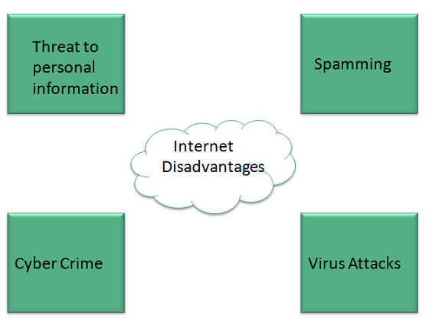
Disadvantages
However, Internet has prooved to be a powerful source of information in almost every field, yet there exists many disadvanatges discussed below:

Slide 30
Cont.
1. There are always chances to loose personal information such as name, address, credit card number. Therefore, one should be very careful while sharing such information. One should use credit cards only through authenticated sites.
2. Another disadvantage is the Spamming.Spamming corresponds to the unwanted e-mails in bulk. These e-mails serve no purpose and lead to obstruction of entire system.
3. Virus can easily be spread to the computers connected to internet. Such virus attacks may cause your system to crash or your important data may get deleted.

Slide 31
Cont.
4. Also a biggest threat on internet is pornography. There are many pornographic sites that can be found, letting your children to use internet which indirectly affects the children healthy mental life.
5. There are various websites that do not provide the authenticated information. This leads to misconception among many people.

Slide 32
Cont.
6. Wastage of times
A lot of time is wasted to collect the information on the Internet. Some people waste a lot of time in chatting or to play games. At home and offices, most of the people use Internet without any positive purpose.

Slide 33
Intranet
Intranet is defined as private network of computers within an organization with its own server and firewall. Moreover we can define Intranet as:
Intranet is system in which multiple PCs are networked to be connected to each other. PCs in intranet are not available to the world outside of the intranet.
Usually each company or organization has their own Intranet network and members/employees of that company can access the computers in their intranet.
Every computer in internet is identified by a unique IP address.
Each computer in Intranet is also identified by a IP Address, which is unique among the computers in that Intranet.

Slide 34
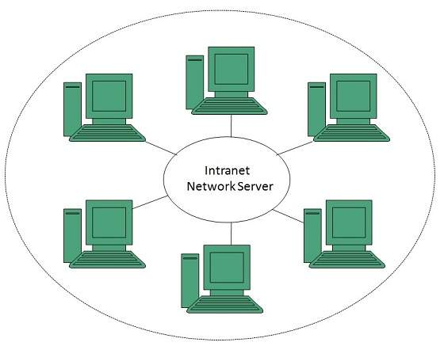
Cont.

Slide 35
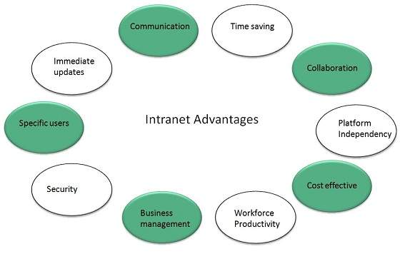
Benefits of Intranet
Intranet is very efficient and reliable network system for any organization. It is beneficial in every aspect such as collaboration, cost-effectiveness, security, productivity and much more.

Slide 36
Cont.
Communication
Intranet offers easy and cheap communication within an organization. Employees can communicate using chat, e-mail or blogs.
Time Saving
Information on Intranet is shared in real time.
Collaboration
Information is distributed among the employees as according to requirement and it can be accessed by the authorized users, resulting in enhanced teamwork.
Platform Independency
Intranet can connect computers and other devices with different architecture.

Slide 37
Cont.
Cost Effective
Employees can see the data and other documents using browser rather than printing them and distributing duplicate copies among the employees, which certainly decreases the cost.
Workforce Productivity
Data is available at every time and can be accessed using company workstation. This helps the employees work faster.
Business Management
It is also possible to deploy applications that support business operations.
Security
Since information shared on intranet can only be accessed within an organization, therefore there is almost no chance of being theft.

Slide 38
Cont.
Specific Users
Intranet targets only specific users within an organization therefore, once can exactly know whom he is interacting.
Immediate Updates
Any changes made to information are reflected immediately to all the users.

Slide 39
Internet vs. Intranet
Apart from similarities there are some differences between the two. Following are the differences between Internet and Intranet:
Intranet | Internet
Localized Network. | Worldwide Network
Doesn't have access to Intranet | Have access to Internet.
More Expensive | Less Expensive
More Safe | Less Safe
More Reliability | Less Reliability

Slide 40
Extranet
Extranet refers to network within an organization, using internet to connect to the outsiders in controlled manner. It helps to connect businesses with their customers and suppliers and therefore allows working in a collaborative manner.
Or
An extranet is like an intranet, but also provides controlled access to authorized customers, vendors, partners, or others outside the company.

Slide 41
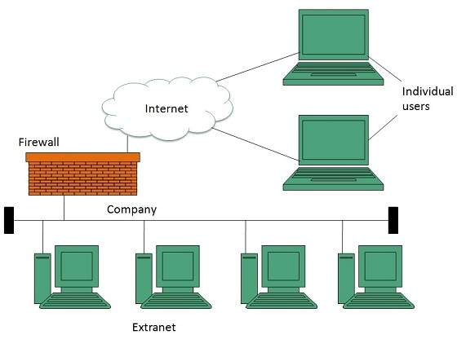
Cont.

Slide 42
Extranet vs. Intranet
The following table shows differences between Extranet and Intranet:
Extranet | Intranet
Internal network that can be accessed externally. | Internal network that can not be accessed externally.
Extranet is extension of company's Intranet. | Only limited users of a company.
For limited external communication between customers, suppliers and business partners. | Only for communication within a company.

Slide 43
Connect to the Internet
The Connect to the Internet wizard will guide you through the steps of setting up an Internet connection.
Step 1:-Open the Connect to the Internet wizard by clicking the Start button
Step 2:-then clicking Control Panel.
Step 3:- In the search box, type network,
Step 4:- click Network and Sharing Center,
Step 5:- click Set up a new connection or network,
Step 6:-then double-click Connect to the Internet.
Note
If you're connected to a local area network, you might already be connected to the Internet.
Step 7:-To find out, open your web browser and try accessing a website.

Slide 44
Introduction to E-mail
What is an Email – Is a method of exchanging digital messages from an author (sender) to one or more recipients (receiver). or
an electronic message transmitted over a network from one user to another.
Can be as simple as a few lines of text, or include attachments such as pictures or documents.

Slide 45
What Makes Up An Email
The Header
Who sent the email.
To whom the mail is sent.
When the email was sent.
The email subject.
The size of the email.

Slide 46
What Makes Up An Email
The Body
Contains the message.
May also contain an attachment.

Slide 47
The Mail Folders
Inbox – new messages as well as messages that have been read
Outbox – messages not yet sent
Sent items – messages that have been sent (moved here from outbox)
Deleted items – messages deleted from any folder
Custom folders – additional folders created by the user

Slide 48
EMAIL ADDRESS
An email address consists of 3 parts:
jackandjill@gmail.com
Unique User Name
chosen by the email account owner
Domain Name
company/organization
providing the email service
“At” sign
Notes:
48

Slide 49
email service providers
There are Two Ways to Get Email
1. Provided by your Internet Service Provider
Monthly fee for internet connection often includes email service.
Aliant - ...@sympatico.ca
Eastlink - …@eastlink.ca
2. Free Web-Based Service Providers
Advertising on the site pays for the service.
Gmail - …@gmail.com
Hotmail - …@hotmail.com

Slide 50
The following table shows the popular email service providers:
S.N. | Service and Description
1. | Gmail Gmail is an email service that allows users to collect all the messages. It also offers approx 7 GB of free storage.
2. | Hotmail Hotmail offers free email and practically unlimited storage accessible on web.
3. | Yahoo Mail Yahoo Mail offers unlimited storage, SMS texting, social networking and instant messaging to boot.
5. | Shortmail Shortmail offers easy and fast email service but with limited 500 characters per message.

Slide 51
E-Mail - Electronic Mail
Send mail electronically via the Internet
Requires an account on a mail server and supporting software on your PC
The username and password will allow you to access your account
All e-mail programs allow you to Send, Compose, Reply, and Forward mail

Slide 52
Cont.
Compose and Send: write an email and send it to others.
Reply: reply to an email that you received.
Forward: pass on an email that you received to others.
Attachment: You can send files with your email such as:pictures, music, software and documents

Slide 53

How to Sign Up for a Gmail Email Account
Go to www.gmail.com
Click on “Sign Up for Gmail”
3. Fill in the
Registration Form

Slide 54
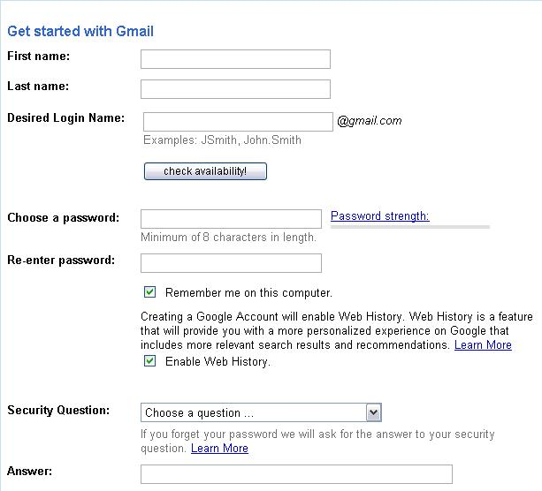
Cont.
Should I provide accurate person information or is it OK to lie?
Unique login name
Password registration boxes and password strength
Description of Google’s Web History
Security question
Answer to the security question

Slide 55
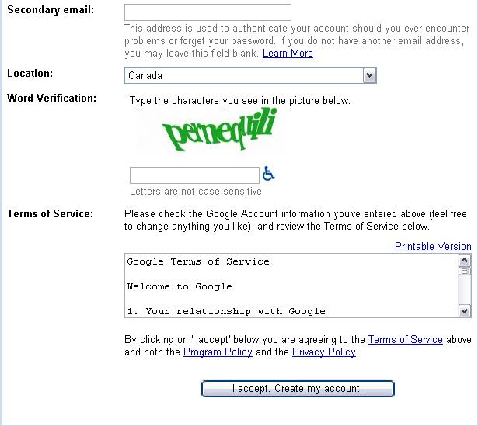
Cont.
Email address for authenticating account
Location of person creating an account
Word verification
Terms of Service policy and links to other user policies
Button for creating Gmail account

Slide 56
Cont.
Upload
Upload is the process of transferring (sending) a file from your own computer to server through a modem or network. The uploaded files are then stored on the website's servers and can be seen by anyone who has Internet access and, if necessary, the right software for viewing it.
Download
Download is the process of retrieving data or file from a server to your own computer either over a network or modem. Each page you visit on the Internet you download to your computer first.

Slide 57
The parts of an email
To : enter the exact email address of your recipient (remember: name@provider.domain)
For multiple recipients, separate each address with a comma
CC : carbon copy- To copy to other people, enter the address of the recipients separated by a comma.
BCC : BLIND carbon copy – The recipient entered here will not be seen by other recipient
Subject : the topic of your email – very important
Body : the message of your email
Attachments : the paperclip symbol - files or photos

Slide 58
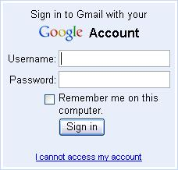
Signing In
Go to www.gmail.com
Type in your username
and password
Click on the ‘sign in’
button

Slide 59
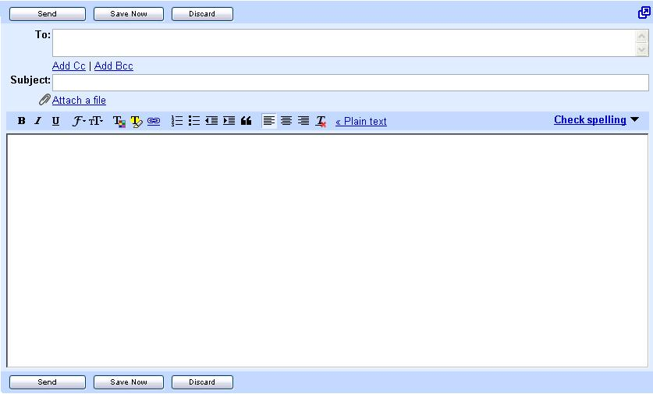
Sending an Email
To: Type full email address of your class partner
Subject: Type a title for your message
Message: Type your message in this box
Send: Used to send emails

Slide 60
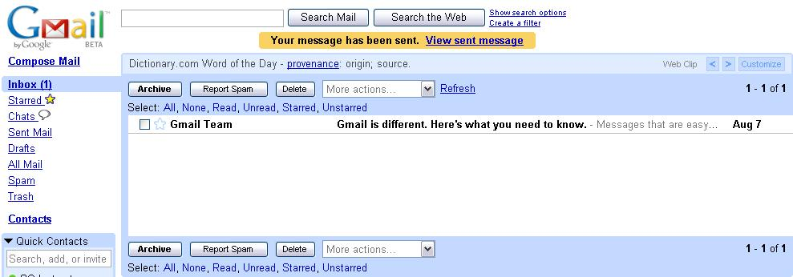
Confirmation message:
Confirmation message and link to sent message

Slide 61
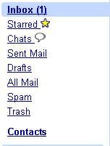
Checking for New Email Messages
The number of new messages in your account appears beside the Inbox link.
Main Menu

Slide 62
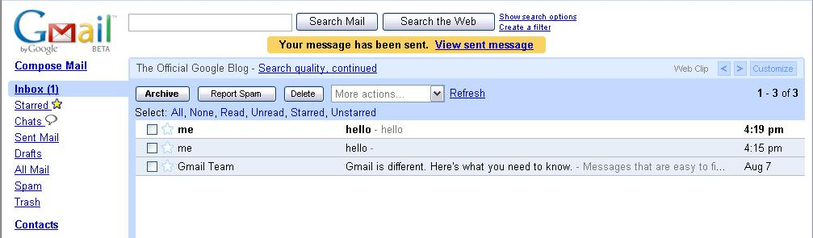
The Inbox
Messages already opened
Un-read message in bold font

Slide 63
Your Messages
Sender
Title
Date
Double click on a subject to read a message

Slide 64
Replying to a Message
“Replying” to a message sends it back to the person who sent it to you.
Procedure:
View the message from your partner
Click on the “Reply Button”
Type in a Reply
Click on Send

Slide 65
Forwarding a Message
By “forwarding” you can pass a message on to other friends.
Procedure:
View the message from your partner
Click on the “Forward” button
Type an address into the “To” box
Click on “Send”

Slide 66

Three Ways to Delete Messages
Click on the delete button while viewing a message
OR
Click on the small arrow next to ‘Reply’ and select ‘Delete Message’
OR
3. From the “Inbox”
Click on the check box beside a message you want to delete
Click on the delete button

Slide 67
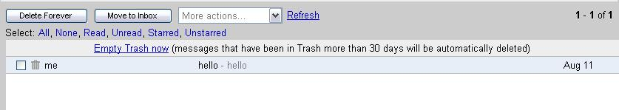
The Trash Folder
Deleted messages go to the “Trash” folder.
If you delete something by accident, you can retrieve it from
“Trash”.
If you delete a message in “Trash”, it is gone for good.
You can delete everything in the “Trash” folder by clicking on
“Empty”

Slide 68
Email Security
Always sign out, especially if you are using a public computer!
Never send your SIN or bank account number by email.
Beware of messages that:
Ask for your bank account information, even if they say they want to put money into your account (e.g. The Nigerian Scam)
Ask you to click on a link, login and verify personal information (e.g. Phishing bank scams)
inform you that you have won a prize/money and ask for personal information in order to give you your prize
Notes:
68

Slide 69
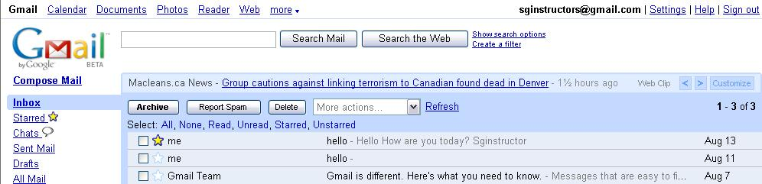
Conclusion
Always Remember to Sign Out!
Notes:
69

Slide 70
Email protocols
E-mails are transferred across the Internet via Simple Mail Transfer Protocol (SMTP).
The mail server uses SMTP to determine how to route the message through the Internet and then sends the message.
When the message arrives at the recipient's mail server, the message is transferred to a POP server. POP stands for Post Office Protocol.
The POP server holds the message until the recipient retrieves it with his/her email software.

Slide 71
The Messaging process
When a message is sent to a mail server it uses SMTP (Simple Mail Transfer Protocol) to send the message.
When the message arrives at the destination server it is then downloaded by a mail client using either POP3(Post Office Protocol ) or IMAP(Internet Message Access Protocol) protocols

Slide 72
Conclusion
Simple Mail Transfer Protocol (SMTP) is an Internet standard for electronic mail (email) transmission.
Post Office Protocol version 3 (POP3) is a standard mail protocol used to receive emails from a remote server to a local email client. POP3 allows you to download email messages on your local computer and read them even when you are offline.
IMAP stands for Internet Message Access Protocol. IMAP shares many similar features with POP3. It, too, is a protocol that an email client can use to download email from an email server. However, IMAP includes many more features than POP3. The IMAP protocol is designed to let users keep their email on the server. IMAP requires more disk space on the server and more CPU resources than POP3

Slide 73
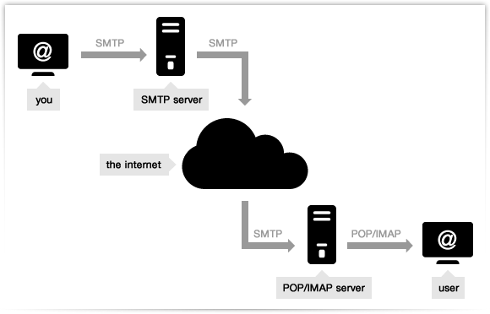
Cont.

Slide 74
DRAFT EMAILS & SAVING FOR LATER
Drafts: When creating an e-mail the computer will automatically save your work periodically. If for any reason you should be interrupted (i.e. lapse in internet connection) you can retrieve your latest work what is called the DRAFT BOX.

Slide 75
The Advantages of E-mail
It's fast - Messages can be sent anywhere around the world in an instant
It's cheap - Transmission usually costs nothing, or at the most, very little
It's simple - Easy to use, after initial set-up
It's efficient - Sending to a group can be done in one step
It's versatile - Pictures, power points or other files can be sent too

Slide 76
The Disadvantages of E-mail
Email can become time consuming for answering complicated questions and misunderstandings can arise because cultural differences in the interpretation of certain words. The telephone is much better for providing detailed answers or if you feel that the question is not absolutely clear.
Email can compromise the security of an organization because sensitive information can be easily distributed accidentally or deliberately. Email should be entrusted to well trained and trusted staff members.
Emails may carry viruses. These are small programs that harm your computer system. They can read out your email address book and send themselves to a number of people around the world.
Your mailbox may get flooded with emails after a certain time so you have to empty it from time to time.
The recipient needs access to the Internet to receive email

Slide 77
Topic 2
STATIC WEBSITE

Slide 78
static website
A static website contains Web pages with fixed content. Each page is coded in HTMLand displays the same information to every visitor.
Static sites are the most basic type of website and are the easiest to create.
Unlike dynamic websites, they do not require any Web programming or database design. A static site can be built by simply creating a few HTML pages and publishing them to a Web server.

Slide 79
Cont..
Advantages of static websites
Quick to develop
Cheap to develop
Cheap to host
Disadvantages of static websites
Requires web development expertise to update site
Site not as useful for the user
Content can get stagnant

Slide 80
HTML
What is HTML?
HTML is a markup languagefor describing web documents (web pages).
HTML stands for Hyper Text Markup Language
A markup language is a set of markup tags
HTML documents are described by HTML tags
Each HTML tag describes different document content

Slide 81
What Is XHTML?
XHTML stands for EXtensible HyperText Markup Language
XHTML is almost identical to HTML
XHTML is stricter than HTML
XHTML is HTML defined as an XML application
XHTML is supported by all major browsers
Why XHTML?
Many pages on the internet contain "bad" HTML.

Slide 82
Cont.
This HTML code works fine in most browsers (even if it does not follow the HTML rules):
<html> <head> <title>This is bad HTML</title> <body> <h1>Bad HTML <p>This is a paragraph </body>

Slide 83
Cont.
Today's market consists of different browser technologies. Some browsers run on computers, and some browsers run on mobile phones or other small devices. Smaller devices often lack the resources or power to interpret "bad" markup.

Slide 84
Cont.
The Most Important Differences from HTML:
Document Structure
XHTML DOCTYPE is mandatory
The xmlns attribute in <html> is mandatory
<html>, <head>, <title>, and <body> are mandatory
XHTML Elements
XHTML elements must be properly nested
XHTML elements must always be closed
XHTML elements must be in lowercase
XHTML documents must have one root element
XHTML Attributes
Attribute names must be in lower case
Attribute values must be quoted
Attribute minimization is forbidden

Slide 85
Cont.
The <html>, <head>, <title>, and <body> elements must also be present, and the xmlns attribute in <html> must specify the xml namespace for the document.

Slide 86
Cont.
This example shows an XHTML document with a minimum of required tags:
<!DOCTYPE html PUBLIC "-//W3C//DTD XHTML 1.0 Transitional//EN" "http://www.w3.org/TR/xhtml1/DTD/xhtml1-transitional.dtd"> <html xmlns="http://www.w3.org/1999/xhtml"> <head> <title>Title of document</title> </head> <body> some content </body> </html>

Slide 87
XHTML Elements Must Be Properly Nested
In HTML, some elements can be improperly nested within each other, like this:
<b><i>This text is bold and italic</b></i>
In XHTML, all elements must be properly nested within each other, like this:
<b><i>This text is bold and italic</i></b>

Slide 88
XHTML Elements Must Always Be Closed
This is wrong:
<p>This is a paragraph <p>This is another paragraph
This is correct:
<p>This is a paragraph</p> <p>This is another paragraph</p>

Slide 89
Empty Elements Must Also Be Closed
This is wrong:
A break: <br> A horizontal rule: <hr> An image: <img src="happy.gif" alt="Happy face">
This is correct:
A break: <br /> A horizontal rule: <hr /> An image: <img src="happy.gif" alt="Happy face" />

Slide 90
XHTML Elements Must Be In Lower Case
This is wrong:
<BODY> <P>This is a paragraph</P> </BODY>
This is correct:
<body> <p>This is a paragraph</p> </body>

Slide 91
XHTML Attribute Names Must Be In Lower Case
This is wrong:
<table WIDTH="100%">
This is correct:
<table width="100%">
Attribute Values Must Be Quoted
This is wrong:
<table width=100%>
This is correct:
<table width="100%">

Slide 92
How to Convert from HTML to XHTML
Add an XHTML <!DOCTYPE> to the first line of every page
Add an xmlns attribute to the html element of every page
Change all element names to lowercase
Close all empty elements
Change all attribute names to lowercase
Quote all attribute values

Slide 93
HTML Editors
HTML can be edited by using professional HTML editors like: Notepad
Follow the 4 steps below to create your first web page with Notepad.
Step 1: Open Notepad
To open Notepad in Windows 7 or earlier:
Click Start (bottom left on your screen). Click All Programs. Click Accessories. Click Notepad.
Step 2: Write Some HTML

Slide 94
Cont.
<!DOCTYPE html>
<html>
<head>
<title>This is document title</title>
</head>
<body>
<h1>This is a heading</h1>
<p>Document content goes here.....</p>
</body> </html>

Slide 95
Cont.
Step 3: Save the HTML Page
Save the file on your computer.
Select File > Save as in the Notepad menu.
Name the file "index.html" or any other name ending with html or htm.
Step 4: View HTML Page in Your Browser
Open the saved HTML file in your favorite browser.

Slide 96
HTML Documents
All HTML documents must start with a type declaration: <!DOCTYPE html>:-This tag defines the document type and HTML version. The <!DOCTYPE> declaration tag is used by the web browser to understand the version of the HTML used in the document. Current version of HTML is 5.
The HTML document itself begins with <html> and ends with </html>:-This tag encloses the complete HTML document and mainly comprises of document header which is represented by<head>...</head> and document body which is represented by <body>...</body> tags.
<head>This tag represents the document's header which can keep other HTML tags like <title>, <link> etc.

Slide 97
Cont.
<title>The <title> tag is used inside the <head> tag to mention the document title.
<body>This tag represents the document's body which keeps other HTML tags like <h1>, <div>, <p> etc. The visible part of the HTML document is between <body> and </body>.
<h1>This tag represents the heading.
<p>This tag represents a paragraph.

Slide 98
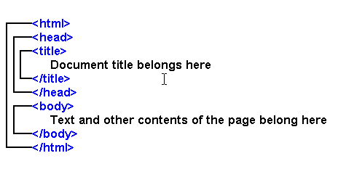
Cont.

Slide 99
HTML elements.
HTML documents are made up by HTML elements.
HTML elements are written with a start tag, with an end tag, with the content in between:
<tagname>content</tagname>
The HTML element is everything from the start tag to the end tag:

Slide 100
Heading Tags
Any document starts with a heading. You can use different sizes for your headings. HTML also has six levels of headings, which use the elements <h1>, <h2>, <h3>, <h4>, <h5>, and <h6>. While displaying any heading, browser adds one line before and one line after that heading.
Example
<!DOCTYPE html>
<html>
<head>
<title>Heading Example</title>
</head>
<body> <h1>This is heading 1</h1>
<h2>This is heading 2</h2>
<h3>This is heading 3</h3>
<h4>This is heading 4</h4>
<h5>This is heading 5</h5>
<h6>This is heading 6</h6>
</body>
</html>

Slide 101
Paragraph Tag
The <p> tag offers a way to structure your text into different paragraphs. Each paragraph of text should go in between an opening <p> and a closing </p> tag as shown below in the example:
<!DOCTYPE html> <html> <head> <title>Paragraph Example</title> </head> <body> <p>Here is a first paragraph of text.</p> <p>Here is a second paragraph of text.</p> <p>Here is a third paragraph of text.</p> </body> </html>

Slide 102
Line Break Tag
Whenever you use the <br /> element, anything following it starts from the next line. This tag is an example of an empty element, where you do not need opening and closing tags, as there is nothing to go in between them.
The <br /> tag has a space between the characters br and the forward slash. If you omit this space, older browsers will have trouble rendering the line break, while if you miss the forward slash character and just use <br> it is not valid in XHTML

Slide 103
Cont.
Example
<!DOCTYPE html>
<html>
<head>
<title>Line Break Example</title>
</head>
<body> <p>Hello<br />
You delivered your assignment ontime.<br /> Thanks<br/>
Mahnaz</p>
</body>
</html>

Slide 104
Centering Content
You can use <center> tag to put any content in the center of the page or any table cell.
Example
<!DOCTYPE html>
<html>
<head>
<title>Centring Content Example</title>
</head>
<body>
<p>This text is not in the center.</p>
<center>
<p>This text is in the center.</p>
</center>
</body>
</html>

Slide 105
Horizontal Lines
Horizontal lines are used to visually break up sections of a document. The <hr>tag creates a line from the current position in the document to the right margin and breaks the line accordingly.
For example you may want to give a line between two paragraphs as in the given example below:
Example
<!DOCTYPE html>
<html>
<head> <title>Horizontal Line Example</title> </head> <body>
<p>This is paragraph one and should be on top</p> <hr />
<p>This is paragraph two and should be at bottom</p> </body>
</html>

Slide 106
HTML Attributes
Attributes provide additional information about HTML elements.
An attribute is used to define the characteristics of an HTML element and is placed inside the element's opening tag. All attributes are made up of two parts: a name and a value:
The name is the property you want to set. For example, the paragraph <p> element in the example carries an attribute whose name is align, which you can use to indicate the alignment of paragraph on the page.
The value is what you want the value of the property to be set and always put within quotations. The below example shows three possible values of align attribute: left, center and right.

Slide 107
example
<!DOCTYPE html>
<html>
<head>
<title>Align Attribute Example</title>
</head>
<body>
<p align="left">This is left aligned</p>
<p align="center">This is center aligned</p>
<p align="right">This is right aligned</p>
</body>
</html>

Slide 108
HTML Formatting
If you use a word processor, you must be familiar with the ability to make text bold, italicized, or underlined;
Bold Text
Anything that appears within <b>...</b> element, is displayed in bold as shown below:

Slide 109
Example
<!DOCTYPE html>
<html>
<head>
<title>Bold Text Example</title>
</head>
<body>
<p>The following word uses a <b>bold</b> typeface.</p>
</body>
</html>

Slide 110
Italic Text
Anything that appears within <i>...</i> element is displayed in italicized as shown below:
Example
<!DOCTYPE html>
<html>
<head>
<title>Italic Text Example</title>
</head>
<body>
<p>The following word uses a <i>italicized</i> typeface.</p>
</body>
</html>

Slide 111
Underlined Text
Anything that appears within <u>...</u> element, is displayed with underline as shown below:
Example
<!DOCTYPE html>
<html>
<head>
<title>Underlined Text Example</title>
</head>
<body>
<p>The following word uses a <u>underlined</u> typeface.</p>
</body>
</html>

Slide 112
Strike Text
Anything that appears within <strike>...</strike> element is displayed with strikethrough, which is a thin line through the text as shown below:
Example
<!DOCTYPE html>
<html>
<head> <title>Strike Text Example</title> </head>
<body> <p>The following word uses a <strike>strikethrough</strike> typeface.</p>
</body>
</html>

Slide 113
Superscript Text
The content of a <sup>...</sup> element is written in superscript; the font size used is the same size as the characters surrounding it but is displayed half a character's height above the other characters.
Example
<!DOCTYPE html>
<html>
<head> <title>Superscript Text Example</title> </head>
<body>
<p>The following word uses a <sup>superscript</sup> typeface.</p>
</body>
</html>

Slide 114
Subscript Text
The content of a <sub>...</sub> element is written in subscript; the font size used is the same as the characters surrounding it, but is displayed half a character's height beneath the other characters.
Example
<!DOCTYPE html>
<html>
<head> <title>Subscript Text Example</title> </head>
<body>
<p>The following word uses a <sub>subscript</sub> typeface.</p>
</body>
</html>

Slide 115
Marked Text
Anything that appears with-in <mark>...</mark> element, is displayed as marked with yellow ink.
Example
<!DOCTYPE html>
<html>
<head> <title>Marked Text Example</title> </head> <body>
<p>The following word has been <mark>marked</mark> with yellow</p>
</body>
</html>

Slide 116
The HTML Style Attribute
Setting the style of an HTML element, can be done with the style attribute.
The HTML style attribute has the following syntax:
<tagname style="property:value;">
The property is a CSS property. The value is a CSS value.
You will learn more about CSS later in this tutorial.
HTML Background Color
The background-color property defines the background color for an HTML element.
This example sets the background color for a page to powderblue:

Slide 117
Example
<body style="background-color:powderblue;"> <h1>This is a heading</h1> <p>This is a paragraph.</p> </body>

Slide 118
HTML Text Color
The color property defines the text color for an HTML element:
Example
<h1 style="color:blue;">This is a heading</h1> <p style="color:red;">This is a paragraph.</p>

Slide 119
HTML Images
Images are very important to beautify as well as to depict many complex concepts in simple way on your web page.
Insert Image
You can insert any image in your web page by using <img> tag. Following is the simple syntax to use this tag.
<img src="url" alt="some_text">
The src attribute specifies the URL (web address) of the image:
The alt attribute specifies an alternate text for an image, if the image cannot be displayed.
The alt attribute provides alternative information for an image if a user for some reason cannot view it (because of slow connection, an error in the src attribute, or if the user uses a screen reader).
If a browser cannot find an image, it will display the alt text:
The <img> tag has no closing tag.

Slide 120
Example
To try following example, let's keep our HTML file test.htm and image file test.png in the same directory:
<!DOCTYPE html>
<html>
<head>
<title>Using Image in Webpage</title>
</head>
<body>
<p>Simple Image Insert</p>
<img src="/html/images/test.png" alt="Test Image" /> </body>
</html>

Slide 121
Set Image Width/Height
You can set image width and height based on your requirement using widthand height attributes. You can specify width and height of the image in terms of either pixels or percentage of its actual size.
Example
<!DOCTYPE html>
<html>
<head>
<title>Set Image Width and Height</title>
</head>
<body>
<p>Setting image width and height</p>
<img src="/html/images/test.png" alt="Test Image" width="150" height="100"/>
</body>
</html>

Slide 122
Set Image Border
By default image will have a border around it, you can specify border thickness in terms of pixels using border attribute. A thickness of 0 means, no border around the picture.
Example
<!DOCTYPE html>
<html>
<head>
<title>Set Image Border</title>
</head>
<body>
<p>Setting image Border</p>
<img src="/html/images/test.png" alt="Test Image" border="3"/>
</body>
</html>

Slide 123
Set Image Alignment
By default image will align at the left side of the page, but you can use align attribute to set it in the center or right.
Example
<!DOCTYPE html>
<html>
<head>
<title>Set Image Alignment</title>
</head>
<body>
<p>Setting image Alignment</p>
<img src="/html/images/test.png" alt="Test Image" border="3" align="right"/>
</body>
</html>

Slide 124
HTML Tables
The HTML tables allow web authors to arrange data like text, images, links, other tables, etc. into rows and columns of cells.
The HTML tables are created using the <table> tag in which the <tr> tag is used to create table rows and <td> tag is used to create data cells.

Slide 125
Example
<!DOCTYPE html>
<html>
<head>
<title>HTML Tables</title> </head>
<body>
<table border="1">
<tr>
<td>Row 1, Column 1</td>
<td>Row 1, Column 2</td>
</tr>
<tr>
<td>Row 2, Column 1</td>
<td>Row 2, Column 2</td>
</tr>
</table>
</body>
</html>

Slide 126
Cont.
Here border is an attribute of <table> tag and it is used to put a border across all the cells. If you do not need a border then you can use border="0".
Table Heading
Table heading can be defined using <th> tag. This tag will be put to replace <td> tag, which is used to represent actual data cell. Normally you will put your top row as table heading as shown below, otherwise you can use <th> element in any row.

Slide 127
example
<!DOCTYPE html>
<html>
<head>
<title>HTML Table Header</title>
</head>
<body>
<table border="1">
<tr> <th>Name</th>
<th>Salary</th> </tr>
<tr> <td>Ramesh Raman</td>
<td>5000</td> </tr>
<tr> <td>Shabbir Hussein</td>
<td>7000</td>
</tr>
</table>
</body>
</html>

Slide 128
Cellpadding and Cellspacing Attributes
There are two attribiutes called cellpadding and cellspacing which you will use to adjust the white space in your table cells. The cellspacing attribute defines the width of the border, while cellpadding represents the distance between cell borders and the content within a cell.

Slide 129
Colspan and Rowspan Attributes
You will use colspan attribute if you want to merge two or more columns into a single column. Similar way you will use rowspan if you want to merge two or more rows.
Example

Slide 130
Cont.
<!DOCTYPE html> <html> <head>
<title>HTML Table Colspan/Rowspan</title>
</head>
<body> <table border="1">
<tr> <th>Column 1</th>
<th>Column 2</th>
<th>Column 3</th> </tr>
<tr><td rowspan="2">Row 1 Cell 1</td>
<td>Row 1 Cell 2</td>
<td>Row 1 Cell 3</td></tr>
<tr><td>Row 2 Cell 2</td>
<td>Row 2 Cell 3</td></tr>
<tr><td colspan="3">Row 3 Cell 1</td></tr>
</table>
</body> </html>

Slide 131
Example
<!DOCTYPE html>
<html>
<head>
<title>HTML Table Cellpadding</title>
</head>
<body> <table border="1" cellpadding="5" cellspacing="5">
<tr>
<th>Name</th>
<th>Salary</th> </tr>
<tr> <td>Ramesh Raman</td>
<td>5000</td> </tr>
<tr> <td>Shabbir Hussein</td>
<td>7000</td> </tr>
</table>
</body>
</html>

Slide 132
Tables Backgrounds
You can set table background using one of the following two ways:
bgcolor attribute - You can set background color for whole table or just for one cell.
background attribute - You can set background image for whole table or just for one cell.
You can also set border color also using bordercolor attribute

Slide 133
Example
<!DOCTYPE html>
<html>
<head>
<title>HTML Table Background</title>
</head>
<body>
<table border="1" bordercolor="green" bgcolor="yellow"> <tr> <th>Column 1</th>
<th>Column 2</th>
<th>Column 3</th> </tr>
<tr><td rowspan="2">Row 1 Cell 1</td>
<td>Row 1 Cell 2</td>
<td>Row 1 Cell 3</td></tr>
<tr><td>Row 2 Cell 2</td>
<td>Row 2 Cell 3</td>
</tr>
<tr><td colspan="3">Row 3 Cell 1</td></tr>
</table>
</body>
</html>

Slide 134
Table Height and Width
You can set a table width and height using width and height attrubutes. You can specify table width or height in terms of pixels or in terms of percentage of available screen area.
Example
<!DOCTYPE html>
<html> <head>
<title>HTML Table Width/Height</title>
</head>
<body> <table border="1" width="400" height="150">
<tr>
<td>Row 1, Column 1</td>
<td>Row 1, Column 2</td>
</tr>
<tr>
<td>Row 2, Column 1</td>
<td>Row 2, Column 2</td>
</tr>
</table> </body> </html>

Slide 135
HTML Lists
HTML offers web authors three ways for specifying lists of information. All lists must contain one or more list elements. Lists may contain:
<ul> - An unordered list. This will list items using plain bullets.
<ol> - An ordered list. This will use different schemes of numbers to list your items.
<dl> - A definition list. This arranges your items in the same way as they are arranged in a dictionary.
HTML Unordered Lists
An unordered list is a collection of related items that have no special order or sequence. This list is created by using HTML <ul> tag. Each item in the list is marked with a bullet.

Slide 136
Example
<!DOCTYPE html>
<html>
<head>
<title>HTML Unordered List</title>
</head>
<body>
<ul>
<li>Beetroot</li>
<li>Ginger</li>
<li>Potato</li>
<li>Radish</li>
</ul>
</body>
</html>

Slide 137
The type Attribute
You can use type attribute for <ul> tag to specify the type of bullet you like. By default it is a disc.
Following are the possible options:
<ul type="square">
<ul type="disc">
<ul type="circle">

Slide 138
Example
Following is an example where we used <ul type="square">
<!DOCTYPE html>
<html>
<head> <title>HTML Unordered List</title>
</head>
<body>
<ul type="square">
<li>Beetroot</li>
<li>Ginger</li>
<li>Potato</li>
<li>Radish</li>
</ul>
</body>
</html>

Slide 139
example
Following is an example where we used <ul type="disc"> :
<!DOCTYPE html>
<html>
<head> <title>HTML Unordered List</title>
</head>
<body>
<ul type="disc">
<li>Beetroot</li>
<li>Ginger</li>
<li>Potato</li>
<li>Radish</li>
</ul>
</body>
</html>

Slide 140
Example
Following is an example where we used <ul type="circle"> :
<!DOCTYPE html>
<html>
<head> <title>HTML Unordered List</title> </head> <body>
<ul type="circle">
<li>Beetroot</li>
<li>Ginger</li>
<li>Potato</li>
<li>Radish</li>
</ul>
</body>
</html>

Slide 141
HTML Ordered Lists
If you are required to put your items in a numbered list instead of bulleted then HTML ordered list will be used. This list is created by using <ol> tag. The numbering starts at one and is incremented by one for each successive ordered list element tagged with <li>.

Slide 142
Example
<!DOCTYPE html>
<html>
<head> <title>HTML Ordered List</title>
</head>
<body>
<ol>
<li>Beetroot</li>
<li>Ginger</li>
<li>Potato</li>
<li>Radish</li>
</ol>
</body>
</html>

Slide 143
The type Attribute
You can use type attribute for <ol> tag to specify the type of numbering you like. By default it is a number. Following are the possible options:
<ol type="1"> - Default-Case Numerals.
<ol type="I"> - Upper-Case Numerals.
<ol type="i"> - Lower-Case Numerals.
<ol type="a"> - Lower-Case Letters.
<ol type="A"> - Upper-Case Letters.

Slide 144
Example
Following is an example where we used <ol type="1">
<!DOCTYPE html>
<html>
<head> <title>HTML Ordered List</title>
</head>
<body>
<ol type="1">
<li>Beetroot</li>
<li>Ginger</li>
<li>Potato</li>
<li>Radish</li>
</ol>
</body>
</html>

Slide 145
Example
Following is an example where we used <ol type="I">
<!DOCTYPE html>
<html>
<head>
<title>HTML Ordered List</title>
</head>
<body> <ol type="I">
<li>Beetroot</li>
<li>Ginger</li>
<li>Potato</li>
<li>Radish</li>
</ol>
</body>
</html>

Slide 146
Example
Example
Following is an example where we used <ol type="i">
<!DOCTYPE html>
<html>
<head>
<title>HTML Ordered List</title>
</head>
<body> <ol type="i">
<li>Beetroot</li>
<li>Ginger</li>
<li>Potato</li>
<li>Radish</li>
</ol>
</body>
</html>

Slide 147
Example
Following is an example where we used <ol type="A">
<!DOCTYPE html>
<html>
<head> <title>HTML Ordered List</title> </head> <body>
<ol type="A">
<li>Beetroot</li>
<li>Ginger</li>
<li>Potato</li>
<li>Radish</li>
</ol>
</body>
</html>

Slide 148
Example
Following is an example where we used <ol type="a">
<!DOCTYPE html>
<html>
<head>
<title>HTML Ordered List</title>
</head>
<body>
<ol type="a">
<li>Beetroot</li>
<li>Ginger</li>
<li>Potato</li>
<li>Radish</li>
</ol>
</body> </html>

Slide 149
HTML Definition Lists
HTML and XHTML support a list style which is called definition lists where entries are listed like in a dictionary or encyclopedia. The definition list is the ideal way to present a glossary, list of terms, or other name/value list.
Definition List makes use of following three tags.
<dl> - Defines the start of the list
<dt> - A term
<dd> - Term definition
</dl> - Defines the end of the list

Slide 150
Example
<!DOCTYPE html>
<html>
<head>
<title>HTML Definition List</title>
</head>
<body>
<dl>
<dt>
<b>HTML</b>
</dt>
<dd>This stands for Hyper Text Markup Language</dd> <dl>
<dt>
<b>HTTP</b>
</dt>
<dd>This stands for Hyper Text Transfer Protocol</dd>
</dl>
</body>
</html>

Slide 151
HTML Text Links
A webpage can contain various links that take you directly to other pages and even specific parts of a given page. These links are known as hyperlinks.
Hyperlinks allow visitors to navigate between Web sites by clicking on words, phrases, and images. Thus you can create hyperlinks using text or images available on a webpage.
A link is specified using HTML tag <a>. This tag is called anchor tag and anything between the opening <a> tag and the closing </a> tag becomes part of the link and a user can click that part to reach to the linked document. Following is the simple syntax to use <a> tag.

Slide 152
Example
Let's try following example which links http://www.tutorialspoint.com at your page:
<!DOCTYPE html>
<html>
<head>
<title>Hyperlink Example</title>
</head>
<body>
<p>Click following link</p>
<a href="http://www.tpsctabora.ac.tz">Tpsc tabora</a>
</body>
</html>
This will produce following result, where you can click on the link generated Tpsc tabora to reach to the home page of Tpsc tabora.

Slide 153
HTML Image Links
We have seen how to create hypertext link using text and we also learnt how to use images in our webpages. Now we will learn how to use images to create hyperlinks.
Example
It's simple to use an image as hyperlink. We just need to use an image inside hyperlink at the place of text as shown below:

Slide 154
example
<!DOCTYPE html>
<html>
<head>
<title>Image Hyperlink Example</title> </head> <body>
<p>Click following link</p>
<a href="http://www.tpsctabora.ac.tz" >
<img src=“logo.jpg" alt=“picture not found" />
</a>
</body>
</html>
This will produce following result, where you can click on the images to reach to the home page of Tpsc tabora.

Slide 155
HTML Backgrounds
By default, your webpage background is white in color. You may not like it, but no worries. HTML provides you following two good ways to decorate your webpage background.
Html Background with Colors
Html Background with Images
Now let's see both the approaches one by one using appropriate examples.

Slide 156
Html Background with Colors
The bgcolor attribute is used to control the background of an HTML element, specifically page body and table backgrounds.
Following is the syntax to use bgcolor attribute with any HTML tag.
<tagname bgcolor="color_value"...>

Slide 157
example
Here are the examples to set background of an HTML tag:
<!DOCTYPE html>
<html>
<head>
<title>HTML Background Colors</title>
</head>
<body bgcolor="yellow">
</body>
</html>

Slide 158
Html Background with Images
The background attribute can also be used to control the background of an HTML elmement, specifically page body and table backgrounds. You can specify an image to set background of your HTML page or table. Following is the syntax to use background attribute with any HTML tag.
<tagname background="Image URL"...>

Slide 159
Example
Here are the examples to set background images of a table.
<!DOCTYPE html>
<html>
<head>
<title>HTML Background Images</title>
</head>
<table background="image.gif" width="100%" height="100">
<tr>
<td> This background is filled up with HTML image. </td>
</tr>
</table>
</body>
</html>

Slide 160
HTML Fonts
Fonts play very important role in making a website more user friendly and increasing content readability. Font face and color depends entirely on the computer and browser that is being used to view your page but you can use HTML <font> tag to add style, size, and color to the text on your website.
The font tag is having three attributes called size, color, and face to customize your fonts. To change any of the font attributes at any time within your webpage, simply use the <font> tag. The text that follows will remain changed until you close with the </font> tag. You can change one or all of the font attributes within one <font> tag.

Slide 161
Set Font Size
You can set content font size using size attribute. The range of accepted values is from 1(smallest) to 7(largest). The default size of a font is 3.
Example
<!DOCTYPE html> <html> <head> <title>Setting Font Size</title> </head> <body> <font size="1">Font size="1"</font><br /> <font size="2">Font size="2"</font><br /> <font size="3">Font size="3"</font><br /> <font size="4">Font size="4"</font><br /> <font size="5">Font size="5"</font><br /> <font size="6">Font size="6"</font><br /> <font size="7">Font size="7"</font> </body> </html>

Slide 162
Setting Font Face
You can set font face using face attribute but be aware that if the user viewing the page doesn't have the font installed, they will not be able to see it. Instead user will see the default font face applicable to the user's computer.
Example
<!DOCTYPE html>
<html>
<head>
<title>Font Face</title>
</head>
<body>
<font face=“Blackadder ITC" size="5">Times New Roman</font>
<br />
<font face="Verdana" size="5">Verdana</font>
<br />
<font face="Comic sans MS" size="5">Comic Sans MS</font>
<br /> <font face="WildWest" size="5">WildWest</font><br />
<font face="Bedrock" size="5">Bedrock</font>
<br />
</body>
</html>

Slide 163
Setting Font Color
You can set any font color you like using color attribute. You can specify the color that you want by either the color name or hexadecimal code for that color.
Example
<!DOCTYPE html>
<html> <head>
<title>Setting Font Color</title>
</head>
<body>
<font color=“blue">This text is in pink</font><br /> <font color="red">This text is red</font>
</body>
</html>

Slide 164
HTML Frames
HTML frames are used to divide your browser window into multiple sections where each section can load a separate HTML document. A collection of frames in the browser window is known as a frameset. The window is divided into frames in a similar way the tables are organized: into rows and columns.
Disadvantages of Frames
There are few drawbacks with using frames, so it's never recommended to use frames in your webpages:
Some smaller devices cannot cope with frames often because their screen is not big enough to be divided up.
Sometimes your page will be displayed differently on different computers due to different screen resolution.
The browser's back button might not work as the user hopes.
There are still few browsers that do not support frame technology.

Slide 165
Creating Frames
To use frames on a page we use <frameset> tag instead of <body> tag. The <frameset> tag defines how to divide the window into frames. The rows attribute of <frameset> tag defines horizontal frames and cols attribute defines vertical frames. Each frame is indicated by <frame> tag and it defines which HTML document shall open into the frame.

Slide 166
Example
Following is the example to create three horizontal frames:
<!DOCTYPE html> <html> <head>
<title>HTML Frames</title>
</head>
<frameset rows="10%,80%,10%">
<frame name="top" src="/html/top_frame.htm" /> <frame name="main" src="/html/main_frame.htm" /> <frame name="bottom" src="/html/bottom_frame.htm" />
<noframes>
<body> Your browser does not support frames.
</body>
</noframes>
</frameset>
</html>

Slide 167
Example
Let's put above example as follows, here we replaced rows attribute by cols and changed their width. This will create all the three frames vertically:
<!DOCTYPE html> <html> <head>
<title>HTML Frames</title>
</head>
<frameset cols="25%,50%,25%">
<frame name="left" src="/html/top_frame.htm" /> <frame name="center" src="/html/main_frame.htm" /> <frame name="right" src="/html/bottom_frame.htm" />
<noframes>
<body> Your browser does not support frames.
</body>
</noframes>
</frameset>
</html>

Slide 168
The <frameset> Tag Attributes
Following are important attributes of the <frameset> tag:
Cols: specifies how many columns are contained in the frameset and the size of each column. You can specify the width of each column in one of four ways:Absolute values in pixels. For example to create three vertical frames, use cols="100, 500,100".
A percentage of the browser window. For example to create three vertical frames, use cols="10%, 80%,10%".
Using a wildcard symbol. For example to create three vertical frames, use cols="10%, *,10%". In this case wildcard takes remainder of the window.
As relative widths of the browser window. For example to create three vertical frames, use cols="3*,2*,1*". This is an alternative to percentages. You can use relative widths of the browser window. Here the window is divided into sixths: the first column takes up half of the window, the second takes one third, and the third takes one sixth.

Slide 169
Cont.
Rows:- This attribute works just like the cols attribute and takes the same values, but it is used to specify the rows in the frameset. For example to create two horizontal frames, use rows="10%, 90%". You can specify the height of each row in the same way as explained above for columns.
Border:- This attribute specifies the width of the border of each frame in pixels. For example border="5". A value of zero means no border.

Slide 170
cont
Frameborder:- This attribute specifies whether a three-dimensional border should be displayed between frames. This attrubute takes value either 1 (yes) or 0 (no). For example frameborder="0" specifies no border.
Framespacing:- This attribute specifies the amount of space between frames in a frameset. This can take any integer value. For example framespacing="10" means there should be 10 pixels spacing between each frames.

Slide 171
The <frame> Tag Attributes
Following are important attributes of <frame> tag:
Src:- This attribute is used to give the file name that should be loaded in the frame. Its value can be any URL. For example, src="/html/top_frame.htm" will load an HTML file available in html directory.
Name:- This attribute allows you to give a name to a frame. It is used to indicate which frame a document should be loaded into. This is especially important when you want to create links in one frame that load pages into an another frame, in which case the second frame needs a name to identify itself as the target of the link.

Slide 172
Cont.
Frameborder:- This attribute specifies whether or not the borders of that frame are shown; it overrides the value given in the frameborder attribute on the <frameset> tag if one is given, and this can take values either 1 (yes) or 0 (no).
Marginwidth:- This attribute allows you to specify the width of the space between the left and right of the frame's borders and the frame's content. The value is given in pixels. For example marginwidth="10".

Slide 173
example
<!DOCTYPE html>
<html> <head>
<title>HTML Target Frames</title> </head> <frameset cols="200, *">
<frame src="/html/menu.htm" name="menu_page" />
<frame src="/html/main.htm" name="main_page" /> <noframes>
<body> Your browser does not support frames. </body>
</noframes>
</frameset>
</html>

Slide 174
cont
Here we have created two columns to fill with two frames. The first frame is 200 pixels wide and will contain the navigation menubar implemented by menu.htm file. The second column fills in remaining space and will contain the main part of the page and it is implemented by main.htm file. For all the three links available in menubar, we have mentioned target frame as main_page, so whenever you click any of the links in menubar, available link will open in main_page.

Slide 175
Following is the content of menu.htm file
<!DOCTYPE html> <html>
<body bgcolor="#4a7d49">
<a href="https://www.google.com" target="main_page">Google</a>
<br /><br />
<a href="https://www.microsoft.com" target="main_page">Microsoft</a> <br /><br />
<a href="https://news.bbc.co.uk" target="main_page">BBC News</a>
</body>
</html>

Slide 176
cont
Following is the content of main.htm file:
<!DOCTYPE html>
<html> <body bgcolor="#b5dcb3">
<h3>This is main page and content from any link will be displayed here.</h3>
<p>So now click any link and see the result.</p> </body>
</html>

Slide 177
HTML Forms
HTML Forms are required when you want to collect some data from the site visitor. For example during user registration you would like to collect information such as name, email address, credit card, etc.
A form will take input from the site visitor and then will post it to a back-end application such as CGI, ASP Script or PHP script etc. The back-end application will perform required processing on the passed data based on defined business logic inside the application.
There are various form elements available like text fields, textarea fields, drop-down menus, radio buttons, checkboxes, etc.
The HTML <form> tag is used to create an HTML form and it has following syntax:

Slide 178
Cont.
<form action="Script URL" method="GET|POST"> form elements like input, textarea etc.
</form>
Form Attributes
Apart from common attributes, following is a list of the most frequently used form attributes:

Slide 179
Cont.
Attribute | Description
action | Backend script ready to process your passed data.
method | Method to be used to upload data. The most frequently used are GET and POST methods.

Slide 180
When to Use GET?
You can use GET (the default method):
The form-data can be sent as URL variables (with method="get")
If the form submission is passive (like a search engine query), and without sensitive information.
When you use GET, the form data will be visible in the page address:
action_page.php?firstname=Mickey&lastname=Mouse
GET is best suited to short amounts of data. Size limitations are set in your browser.

Slide 181
When to Use POST?
You should use POST:
The form-data can be sent as HTTP post transaction (with method="post").
If the form is updating data, or includes sensitive information (password).
POST offers better security because the submitted data is not visible in the page address.

Slide 182
HTML Form Controls
There are different types of form controls that you can use to collect data using HTML form:
Text Input Controls
Checkboxes Controls
Radio Box Controls
Select Box Controls
File Select boxes
Hidden Controls
Clickable Buttons
Submit and Reset Button

Slide 183
Text Input Controls
There are three types of text input used on forms:
Single-line text input controls - This control is used for items that require only one line of user input, such as search boxes or names. They are created using HTML <input> tag.
Password input controls - This is also a single-line text input but it masks the character as soon as a user enters it. They are also created using HTMl <input> tag.
Multi-line text input controls - This is used when the user is required to give details that may be longer than a single sentence. Multi-line input controls are created using HTML <textarea> tag.

Slide 184
Single-line text input controls
This control is used for items that require only one line of user input, such as search boxes or names. They are created using HTML <input> tag.
Example
Here is a basic example of a single-line text input used to take first name and last name:

Slide 185
Cont.
<!DOCTYPE html>
<html>
<head>
<title>Text Input Control</title>
</head>
<body>
<form >
First name: <input type="text" name="first_name" />
<br>
Last name: <input type="text" name="last_name" /> </form>
</body>
</html>

Slide 186
Cont.
Attributes
Following is the list of attributes for <input> tag for creating text field.
Attribute | Description
type | Indicates the type of input control and for text input control it will be set to text.
name | Used to give a name to the control which is sent to the server to be recognized and get the value.
value | This can be used to provide an initial value inside the control.

Slide 187
Password input controls
This is also a single-line text input but it masks the character as soon as a user enters it. They are also created using HTML <input> tag but type attribute is set to password.
Example
Here is a basic example of a single-line password input used to take user password:

Slide 188
Cont.
<!DOCTYPE html>
<html>
<head>
<title>Password Input Control</title>
</head>
<body> <form > User ID : <input type="text" name="user_id" />
<br>
Password: <input type="password" name="password" />
</form>
</body>
</html>

Slide 189
Cont.
Attributes
Following is the list of attributes for <input> tag for creating password field.
Attribute | Description
type | Indicates the type of input control and for password input control it will be set to password.
name | Used to give a name to the control which is sent to the server to be recognized and get the value.
value | This can be used to provide an initial value inside the control.

Slide 190
Multiple-Line Text Input Controls
This is used when the user is required to give details that may be longer than a single sentence. Multi-line input controls are created using HTML <textarea> tag.
Example
Here is a basic example of a multi-line text input used to take item description:

Slide 191
Cont.
<!DOCTYPE html>
<html>
<head>
<title>Multiple-Line Input Control</title> </head> <body>
<form>
Description : <br />
<textarea name="description"> Enter description here... </textarea>
</form>
</body>
</html>

Slide 192
Radio Button Control
Radio buttons are used when out of many options, just one option is required to be selected. They are also created using HTML <input> tag but type attribute is set to radio.
Example
Here is example HTML code for a form with two radio buttons:

Slide 193
example
<!DOCTYPE html>
<html>
<head>
<title>Radio Box Control</title> </head>
<body>
<form> <input type="radio" name="subject" >Maths
<input type="radio" name="subject" >Physics
</form>
</body>
</html>

Slide 194
Select Box Control
A select box, also called drop down box which provides option to list down various options in the form of drop down list, from where a user can select one or more options.
Example
Here is example HTML code for a form with one drop down box

Slide 195
example
<!DOCTYPE html>
<html>
<head> <title>Select Box Control</title> </head> <body>
<form>
<select name="dropdown">
<option >Maths</option>
<option >Physics</option>
</select>
</form>
</body>
</html>

Slide 196
List Box
Creates a list box.
Example
<select multiple name="strScroll" > <option>Marketing Manager <option/>
<option>Marketing Assistant <option/>
<option> Accounting Manager <option/>
<option> Sales Agent <option/>
<option> Sales Associate <option/>
</select>

Slide 197
Checkbox Control
Checkboxes are used when more than one option is required to be selected. They are also created using HTML <input> tag but type attribute is set tocheckbox.
Example
Here is an example HTML code for a form with two checkboxes:

Slide 198
example
<!DOCTYPE html>
<html>
<head>
<title>Checkbox Control</title>
</head>
<body>
<form>
<input type="checkbox" name="maths" > Maths
<input type="checkbox" name="physics" > Physics
</form>
</body>
</html>

Slide 199
File Upload Box
If you want to allow a user to upload a file to your web site, you will need to use a file upload box, also known as a file select box. This is also created using the <input> element but type attribute is set to file.
Example
Here is example HTML code for a form with one file upload box:

Slide 200
example
<!DOCTYPE html>
<html>
<head>
<title>File Upload Box</title> </head>
<body>
<form>
<input type="file" name="fileupload" />
</form>
</body>
</html>

Slide 201
Button Controls
There are various ways in HTML to create clickable buttons. You can also create a clickable button using <input> tag by setting its type attribute to button.
The type attribute can take the following values:

Slide 202
Cont.
Type | Description
submit | This creates a button that automatically submits a form.
reset | This creates a button that automatically resets form controls to their initial values.
button | This creates a button that is used to trigger a client-side script when the user clicks that button.

Slide 203
example
<!DOCTYPE html>
<html>
<head>
<title>File Upload Box</title>
</head>
<body>
<form>
<input type="submit" name="submit" value="Submit" />
<input type="reset" name="reset" value="Reset" />
<input type="button" name="ok" value="OK" />
</form>
</body>
</html>

Slide 205
HTML Marquees
An HTML marquee is a scrolling piece of text displayed either horizontally across or vertically down your webpage depending on the settings. This is created by using HTML <marquee> tag.
Syntax
A simple syntax to use HTML <marquee> tag is as follows:
<marquee attribute_name="attribute_value"....more attributes> One or more lines or text message or image </marquee>

Slide 206
Examples - 1
<!DOCTYPE html>
<html>
<head>
<title>HTML marquee Tag</title>
</head>
<body>
<marquee>This is basic example of marquee
</marquee>
</body>
</html>

Slide 207
Examples - 2
<!DOCTYPE html>
<html>
<head>
<title>HTML marquee Tag</title>
</head>
<body>
<marquee direction="right">This text will scroll from left to right
</marquee>
</body>
</html>

Slide 208
Examples - 4
<!DOCTYPE html>
<html>
<head>
<title>HTML marquee Tag</title>
</head>
<body>
<marquee direction="up">This text will scroll from bottom to up</marquee>
</body>
</html>

Slide 209
Examples - 5
We're going to use the <marquee> tag to make writing and pictures move .
Example
<!DOCTYPE html>
<html>
<body>
<marquee behavior="slide" direction="left">
<img src="btc.jpg" width="125" height="82" alt="Flying Bat">
<img src="btc.jpg" width="125" height="82" alt="Flying Bat">
</marquee>
</body>
</html>

Slide 210
Examples - 6
<!DOCTYPE html>
<html>
<body>
<marquee behavior="scroll" direction="right" scrollamount="30">
<img src="btc.jpg" width="72" height="79" alt="Flying Bee">
</marquee>
</body>
</html>

Slide 211
Examples - 7
<!DOCTYPE html>
<html>
<body>
<marquee behavior="alternate">
<img src="btc.jpg" width="33" height="34" alt="Bouncing ball">
</marquee>
</body>
</html>
.

Slide 212
Cascading Style Sheets(CSS)
What is CSS?
CSS stands for Cascading Style Sheets
CSS describes how HTML elements are to be displayed on screen, paper, or in other media OR
Cascading Style Sheets, fondly referred to as CSS, is a simple design language intended to simplify the process of making web pages presentable.
CSS handles the look and feel part of a web page. Using CSS, you can control the color of the text, the style of fonts, the spacing between paragraphs, how columns are sized and laid out, what background images or colors are used, layout designs,variations in display for different devices and screen sizes as well as a variety of other effects.
CSS is easy to learn and understand but it provides powerful control over the presentation of an HTML document. Most commonly, CSS is combined with the markup languages HTML or XHTML.

Slide 213
Advantages of CSS
CSS saves time − You can write CSS once and then reuse same sheet in multiple HTML pages. You can define a style for each HTML element and apply it to as many Web pages as you want.
Pages load faster − If you are using CSS, you do not need to write HTML tag attributes every time. Just write one CSS rule of a tag and apply it to all the occurrences of that tag. So less code means faster download times.
Easy maintenance − To make a global change, simply change the style, and all elements in all the web pages will be updated automatically.
Superior styles to HTML − CSS has a much wider array of attributes than HTML, so you can give a far better look to your HTML page in comparison to HTML attributes.

Slide 214
Cont.
Offline Browsing − CSS can store web applications locally with the help of an offline catche. Using of this, we can view offline websites. The cache also ensures faster loading and better overall performance of the website.

Slide 215
A CSS style rules
A CSS comprises of style rules that are interpreted by the browser and then applied to the corresponding elements in your document. A style rule is made of three parts −
Selector − A selector is an HTML tag at which a style will be applied. This could be any tag like <h1> or <table> etc.
Property - A property is a type of attribute of HTML tag. Put simply, all the HTML attributes are converted into CSS properties. They could be color, border etc.
Value - Values are assigned to properties. For example, color property can have value either red or #F1F1F1 etc.

Slide 216
CSS Style Rule Syntax
You can put CSS Style Rule Syntax as follows −
selector { property: value; }
Example
h1 {color: red; }
Here h1 is a selector and color is a property and red is the value of that property.

Slide 217
CONT
Three Ways to Insert CSS
There are three ways of inserting a style sheet:
External style sheet
Internal style sheet
Inline style

Slide 218
External Style Sheet
The <link> element can be used to include an external stylesheet file in your HTML document.
An external style sheet is a separate text file with .css extension. You define all the Style rules within this text file and then you can include this file in any HTML document using <link> element.
Here is the generic syntax of including external CSS file:
<head>
<link type="text/css" href="..." />
</head>

Slide 219
Attribute | Value | Description
type | text/css | Specifies the style sheet language as a content-type (MIME type). This attribute is required.
href | URL | Specifies the style sheet file having Style rules. This attribute is a required.

Slide 220
example
Consider a simple style sheet file with a name mystyle.css having the following rules:
h1, h2, h3 {
color: #36C;
font-weight: normal;
letter-spacing: .4em;
margin-bottom: 1em;
text-transform: lowercase;
}
Now you can include this file mystyle.css in any HTML document as follows:
<head>
<link type="text/css" href="mystyle.css" media="all" />
</head>

Slide 221
CONT
An external style sheet can be written in any text editor. The file should not contain any html tags. The style sheet file must be saved with a .css extension.
Here is how the "mystyle.css" looks:
body { background-color: lightblue; } h1 { color: navy; margin-left: 20px; }

Slide 222
Internal Style Sheet
An internal style sheet may be used if one single page has a unique style.
Internal styles are defined within the <style> element, inside the <head> section of an HTML page:
Example
<head> <style> body { background-color: linen; } h1 { color: maroon; margin-left: 40px; } </style> </head>

Slide 223
Inline Styles
An inline style may be used to apply a unique style for a single element.
To use inline styles, add the style attribute to the relevant element. The style attribute can contain any CSS property.
The example below shows how to change the color and the left margin of a <h1> element:
Example
<h1 style="color:blue;margin-left:30px;">
This is a heading
</h1>

Slide 224
Attributes
Attributes associated with <style> elements are −
Attribute | Value | Description
type | text/css | Specifies the style sheet language as a content-type (MIME type). This attribute is required.
href | URL | Specifies the style sheet file having Style rules. This attribute is a required.
media | screen tty tv projection handheld print braille aural all | Specifies the device the document will be displayed on. Default value is all. This is optional attribute.

Slide 225
CSS Rules Overriding
We have discussed four ways to include style sheet rules in a an HTML document. Here is the rule to override any Style Sheet Rule.
Any inline style sheet takes highest priority. So, it will override any rule defined in <style>...</style> tags or rules defined in any external style sheet file.
Any rule defined in <style>...</style> tags will override rules defined in any external style sheet file.
Any rule defined in external style sheet file takes lowest priority, and rules defined in this file will be applied only when above two rules are not applicable.

Slide 226
CSS - Measurement Units
Unit | Description | Example
% | Defines a measurement as a percentage relative to another value, typically an enclosing element. | p {font-size: 16pt; line-height: 125%;}
em | A relative measurement for the height of a font in em spaces. Because an em unit is equivalent to the size of a given font, if you assign a font to 12pt, each "em" unit would be 12pt; thus, 2em would be 24pt. | p {letter-spacing: 7em;}
ex | This value defines a measurement relative to a font's x-height. The x-height is determined by the height of the font's lowercase letter x. | p {font-size: 24pt; line-height: 3ex;}
pt | Defines a measurement in points. A point is defined as 1/72nd of an inch. | body {font-size: 18pt;}
px | Defines a measurement in screen pixels. | p {padding: 25px;}

Slide 227
CSS - Colors
Format | Syntax | Example
Hex Code | #RRGGBB | p{color:#FF0000;}
Short Hex Code | #RGB | p{color:#6A7;}
RGB % | rgb(rrr%,ggg%,bbb%) | p{color:rgb(50%,50%,50%);}

Slide 228
CSS Colors - Hex Codes
A hexadecimal is a 6 digit representation of a color. The first two digits(RR) represent a red value, the next two are a green value(GG), and the last are the blue value(BB).
A hexadecimal value can be taken from any graphics software like Adobe Photoshop, Jasc Paintshop Pro, or even using Advanced Paint Brush.
Each hexadecimal code will be preceded by a pound or hash sign '#'.

Slide 229
CSS - Background
This chapter teaches you how to set backgrounds of various HTML elements. You can set the following background properties of an element −
The background-color property is used to set the background color of an element.
The background-image property is used to set the background image of an element.
The background-repeat property is used to control the repetition of an image in the background.
The background-position property is used to control the position of an image in the background.
The background-attachment property is used to control the scrolling of an image in the background.
The background property is used as a shorthand to specify a number of other background properties.

Slide 230
Set the Background Color
Following is the example which demonstrates how to set the background color for an element.
<html> <head>
<body>
<p style = "background-color:yellow;"> This text has a yellow background color.
</p>
</body>
</head>
<html>

Slide 231
Set the Background Image
We can set the background image by calling local stored images as shown below
<html>
<head>
<style>
body
{ background-image: url("css.jpg");
background-color: #cccccc; }
</style> <body>
<h1>Hello World!</h1>
</body> </head> <html>

Slide 232
CSS - Fonts
This chapter teaches you how to set fonts of a content, available in an HTML element. You can set following font properties of an element −
The font-family property is used to change the face of a font.
The font-style property is used to make a font italic or oblique.
The font-variant property is used to create a small-caps effect.
The font-weight property is used to increase or decrease how bold or light a font appears.
The font-size property is used to increase or decrease the size of a font.
The font property is used as shorthand to specify a number of other font properties.

Slide 233
example
<html> <head> </head>
<body>
<p style="font-family:georgia,garamond,serif;"> This text is rendered in either georgia, garamond, or the default serif font depending on which font you have at your system.
</p>
</body>
</html>

Slide 234
Set the Font Size
The following example demonstrates how to set the font size of an element. The font-size property is used to control the size of fonts. Possible values could be xx-small, x-small, small, medium, large, x-large, xx-large, smaller, larger, size in pixels or in %.
<html> <head> </head> <body>
<p style="font-size:20px;">This font size is 20 pixels</p>
<p style="font-size:small;">
This font size is small</p>
<p style="font-size:large;">
This font size is large</p>
</body> </html>

Slide 235
Set the Space between Characters
The following example demonstrates how to set the space between characters. Possible values are normal or a number specifying space..
<html> <head> </head> <body> <p style="letter-spacing:5px;"> This text is having space between letters. </p> </body> </html>

Slide 236
Set the Space between Words
The following example demonstrates how to set the space between words. Possible values are normal or a number specifying space.
<html> <head> </head> <body> <p style="word-spacing:5px;"> This text is having space between words. </p> </body> </html>

Slide 237
CSS Forms
The example above applies to all <input> elements. If you only want to style a specific input type, you can use attribute selectors:
input[type=text] - will only select text fields
input[type=password] - will only select password fields
input[type=number] - will only select number fields
etc..

Slide 238
example
<!DOCTYPE html>
<html>
<head>
<style>
input[type=text] {
width: 100%;
padding: 12px 20px;
margin: 8px 0;
box-sizing: border-box;
}
</style>
</head>
<body>
<p>Padded text fields:</p>
<form>
<label for="fname">First Name</label>
<input type="text" id="fname" name="fname">
<label for="lname">Last Name</label>
<input type="text" id="lname" name="lname">
</form>
</body>
</html>

Slide 239
Bordered Inputs
Use the border property to change the border size and color, and use the border-radius property to add rounded corners:

Slide 240
example
<!DOCTYPE html>
<html>
<head>
<style>
input[type=text] {
width: 100%;
padding: 12px 20px;
margin: 8px 0;
box-sizing: border-box;
border: 2px solid red;
border-radius: 4px;
}
</style>
</head>
<body>
<p>Text fields with borders:</p>
<form>
<label for="fname">First Name</label>
<input type="text" id="fname" name="fname">
<label for="lname">Last Name</label>
<input type="text" id="lname" name="lname">
</form>
</body>
</html>

Slide 241
Colored Inputs
Use the background-color property to add a background color to the input, and the color property to change the text color:

Slide 242
example
<!DOCTYPE html>
<html>
<head>
<style>
input[type=text] {
width: 100%;
padding: 12px 20px;
margin: 8px 0;
box-sizing: border-box;
border: none;
background-color: #3CBC8D;
color: white;
}
</style>
</head>
<body>
<p>Colored text fields:</p>
<form>
<label for="fname">First Name</label>
<input type="text" id="fname" name="fname" value="John">
<label for="lname">Last Name</label>
<input type="text" id="lname" name="lname" value="Doe">
</form>
</body>

Slide 243
Input with icon/image
If you want an icon inside the input, use the background-image property and position it with the background-position property. Also notice that we add a large left padding to reserve the space of the icon:

Slide 244
example
<!DOCTYPE html>
<html>
<head>
<style>
input[type=text] {
width: 100%;
box-sizing: border-box;
border: 2px solid #ccc;
border-radius: 4px;
font-size: 16px;
background-color: white;
background-image: url('searchicon.png');
background-position: 10px 10px;
background-repeat: no-repeat;
padding: 12px 20px 12px 40px;
}
</style>
</head>
<body>
<p>Input with icon:</p>
<form>
<input type="text" name="search" placeholder="Search..">
</form>
</body>
</html>

Slide 245
CSS border
Example
<!DOCTYPE html>
<html>
<style>
p {
border-style: solid;
}
</style>
<body>
<p> The "border-bottom-width" property does not work if it is used alone. Use the "border-style" property to set the borders first.</p>
</body>
</html>

Slide 246
Cont.
<!DOCTYPE html>
<html>
<style>
p {
border-style: solid;
border-color:red;
}
</style>
<body>
<p> The "border-bottom-width" property does not work if it is used alone. Use the "border-style" property to set the borders first.</p>
</body>
</html>

Slide 247
CSS font size
example
<html>
<style>
h1 { font-size:25;}
h2 { font-size:20;}
p { font-size:100;}
</style>
<body>
<h1>This is heading 1</h1>
<h2>This is heading 2</h2>
<p>This is a paragraph.</p>
</body>
</html>

Slide 248
CSS Tables
Table Borders
To specify table borders in CSS, use the border property.
Example
<html>
<head>
<style>
table {
border-collapse: collapse;
width: 100%;
}
th, td {
text-align: left;
padding: 8px;
}
tr:nth-child(even){background-color: #f2f2f2}
th {
background-color: #4CAF50;
color: white;
}
</style>
</head>

Slide 249
Cont.
<body>
<h2>Colored Table Header</h2>
<table>
<tr>
<th>Firstname</th>
<th>Lastname</th>
<th>Savings</th>
</tr>
<tr>
<td>Peter</td>
<td>Griffin</td>
<td>$100</td>
</tr>
<tr>
<td>Lois</td>
<td>Griffin</td>
<td>$150</td>
</tr>

Slide 250
Cont.
<tr>
<td>Joe</td>
<td>Swanson</td>
<td>$300</td>
</tr>
<tr>
<td>Cleveland</td>
<td>Brown</td>
<td>$250</td>
</tr>
</table>
</body>
</html>

